Slide 1
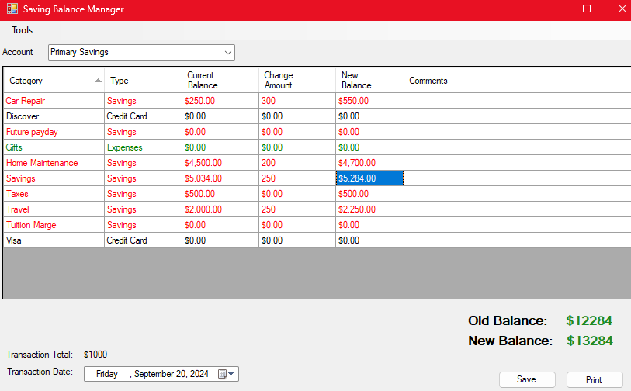
Enter your deposit amounts here.
This should match your bank balance after you transfer.
View total transaction amount (this would match your bank transaction)
Save the transaction when done.

Slide 2
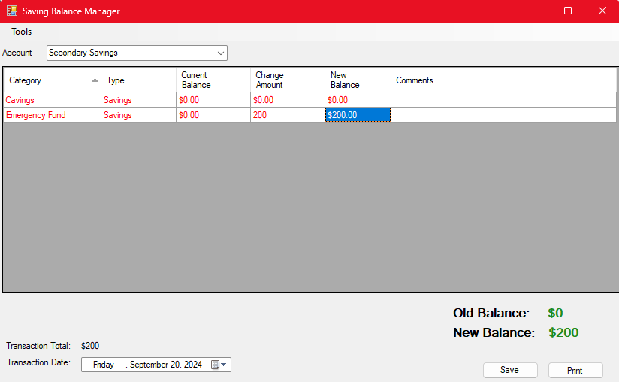
Change to the other account
Enter your deposit amounts here.
Save the transaction when done.

Slide 3
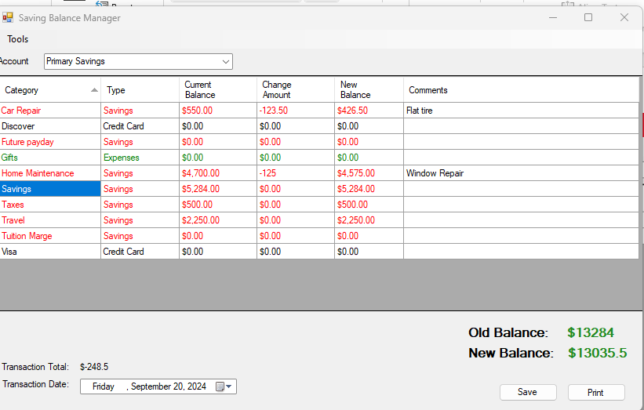
Add comments
Enter the amounts
Transfer to checking to cover the checks.

